Slide 1
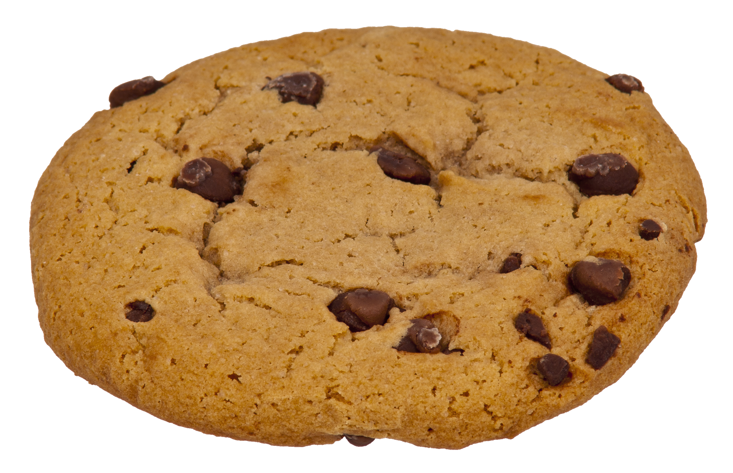
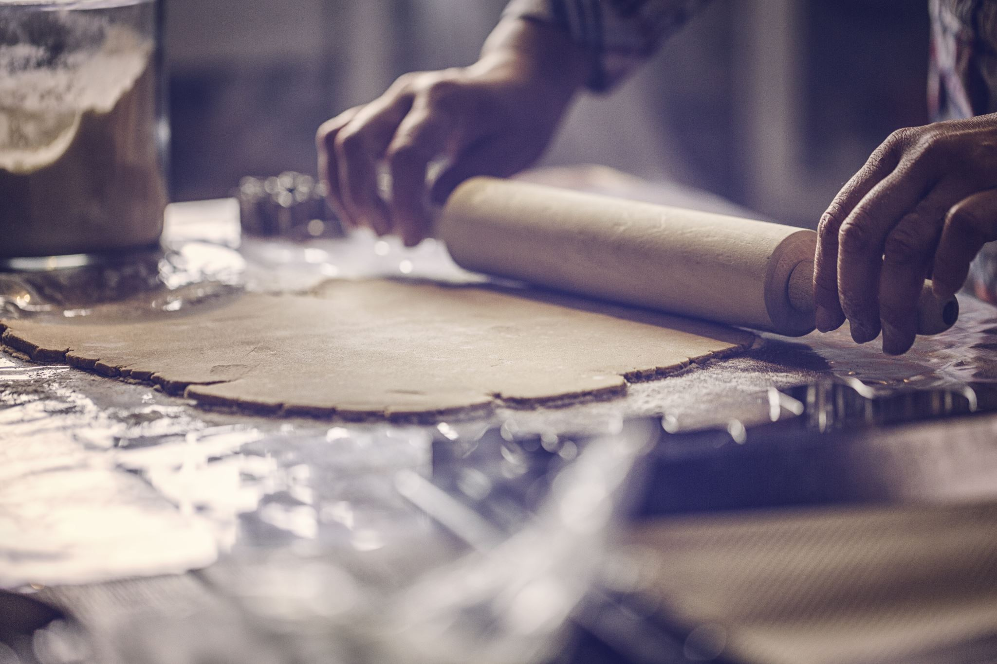
My Cookie Company

Slide 2

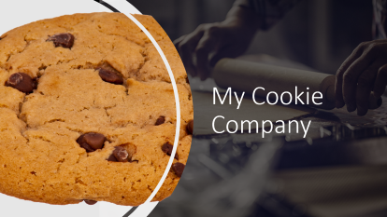
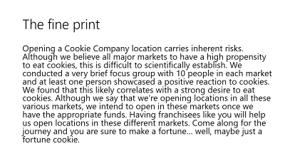

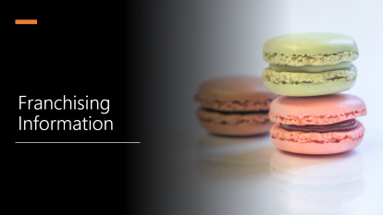
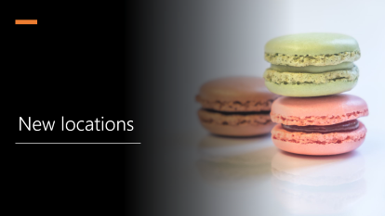
Summary

Slide 3

New locations

Slide 4
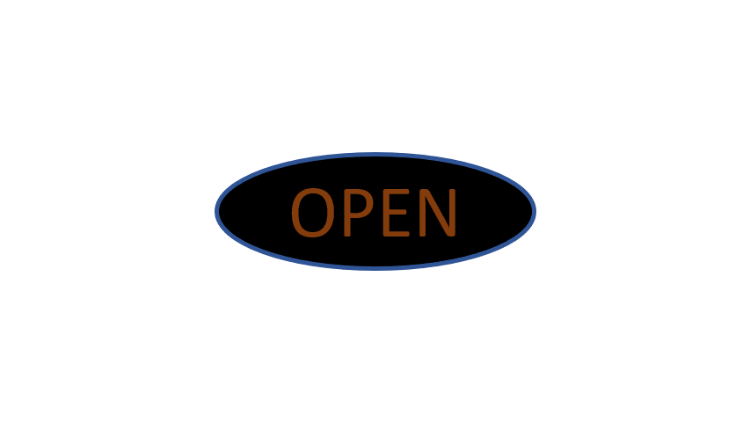

London
Beijing
New York
Frankfurt

Slide 5
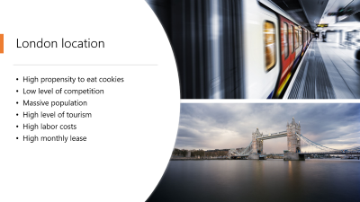
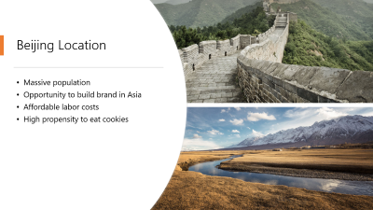
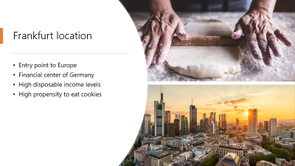
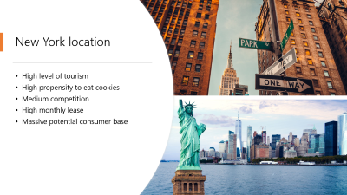

Slide 6


London location
High propensity to eat cookies
Low level of competition
Massive population
High level of tourism
High labor costs
High monthly lease

Slide 7


Beijing Location
Massive population
Opportunity to build brand in Asia
Affordable labor costs
High propensity to eat cookies

Slide 8


New York location
High level of tourism
High propensity to eat cookies
Medium competition
High monthly lease
Massive potential consumer base

Slide 9


Frankfurt location
Entry point to Europe
Financial center of Germany
High disposable income levels
High propensity to eat cookies

Slide 10
Franchising Information

Slide 11


Sign up today
Only $1,000,000 to get started with your own location!
Powerful brand, well known on YouTube tutorial videos
Personal attention from founder, Kevin Stratvert
Attentive brand management staff
Don’t wait, get started today!

Slide 12
About

Slide 13
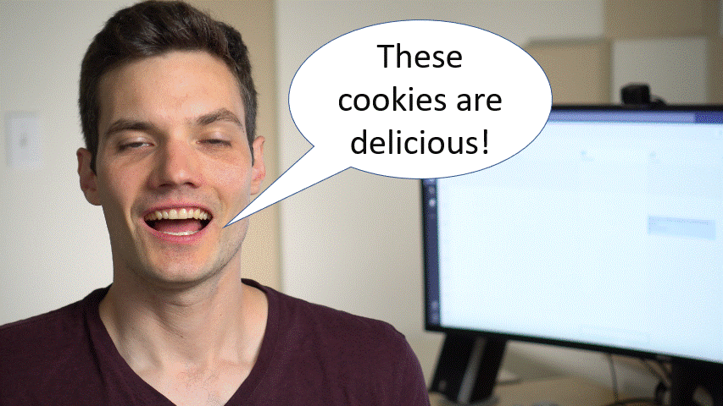

Slide 14
The fine print
Opening a Cookie Company location carries inherent risks. Although we believe all major markets to have a high propensity to eat cookies, this is difficult to scientifically establish. We conducted a very brief focus group with 10 people in each market and at least one person showcased a positive reaction to cookies. We found that this likely correlates with a strong desire to eat cookies. Although we say that we’re opening locations in all these various markets, we intend to open in these markets once we have the appropriate funds. Having franchisees like you will help us open locations in these different markets. Come along for the journey and you are sure to make a fortune… well, maybe just a fortune cookie.

